Slide 1
Azure Notification Hub with Xamarin
Sohel Shekha
bit.ly/shekha
quora.com/profile/Sohel-Shekha-1
@ShekhaSohel

Slide 2
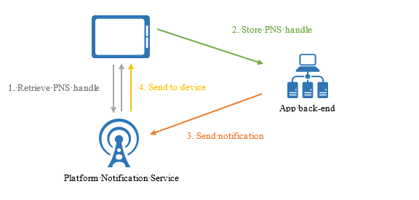
Image Source: https://docs.microsoft.com/en-us/azure/notification-hubs/media/notification-hubs-overview/registration-diagram.png

Slide 3
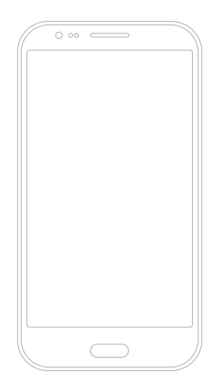

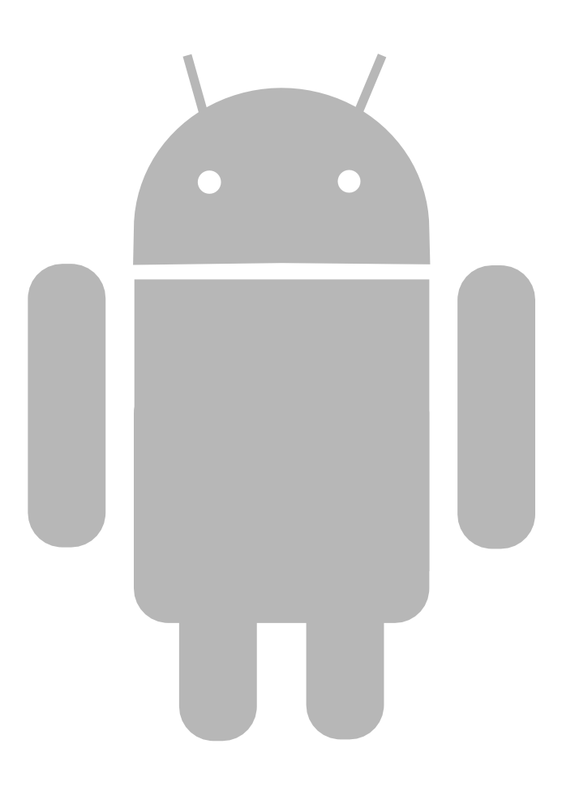
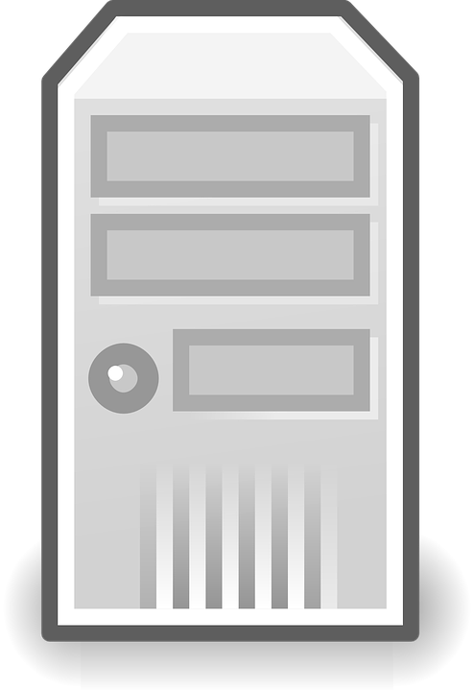
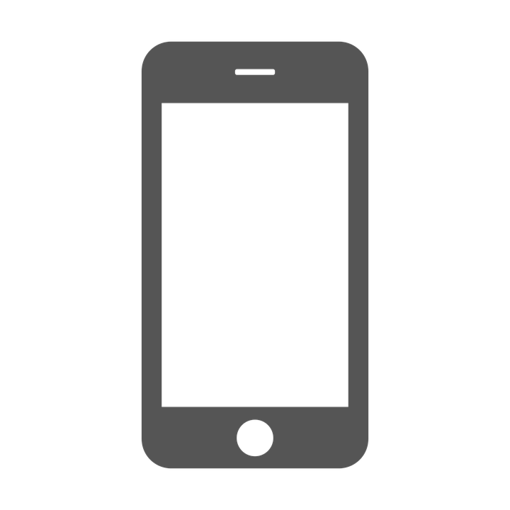

Android
Firebase Cloud Messaging
Backend
iOS
Apple Push Notification Service

Slide 4
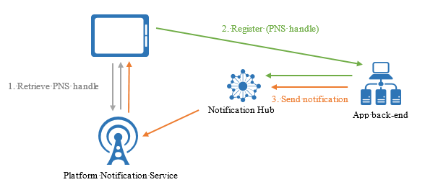
Image Source: https://docs.microsoft.com/en-us/azure/notification-hubs/media/notification-hubs-overview/notification-hub-diagram.png

Slide 5

Android
Firebase Cloud Messaging
Azure Notification Hub
Backend
iOS
Apple Push Notification Service

Slide 6

Few scenarios
Location based services
Promotional contents
Send Reminders
Multi-factor Authentication
Notes:
Tripadvisor…. Foodpanda…… Meetup…… Telegram

Slide 7
When to use Azure Notification Hub
Cross Platform
Common Interface & Device registration
Delivery Patterns
Personalize Push
Scalability
Integrated in Azure App Services
Notes:
Not only Android, iOS, Windows... but also Kindle, Baidu….
Single or Multi Platform, User or Device, Schedule Push

Slide 8
Video:
Code Sample at:

Slide 9
Video link:
Code link:

